Slide 1
Presentation of the B-WISE Report on current situation of skills gaps in WISEs
Giulia Galera, Euricse
Lieven Bossuyt, Lichtwerk

Slide 2
WISEs: development in Europe
  Limits of labour policies
  Demographic and social changes
  Cultural evolution
  Deinstitutionalization
  From below: family members, recipients, supporters, community
  Evolution of sheltered workshops
  New model of enterprise=WISE
Driver
Reaction
Development

Slide 3
WISE specificities
Institutional mechanism of supported employment
favouring workers discriminated against by conventional enterprises by providing them with appropriate on-the-job training
Double output enterprises:
  Marketable goods and/or services
  Work (and social) integration of workers with support needs (WSNs)
Sectors of activity and organization of work functional to WSNs interests, capabilities, expectations and needs
Combination of employment & training

Slide 4
WISE resources
Typologies | Public | Private
Non-monetary resources | Public assets mande available by public authorities | Voluntary contributions and assets made available by private enterprises and individuals
Non-repayable resources | Public subsidies and grants | Private contributions, indivisible reserves accumulated thanks to non distribution constraint, donations
Repayable resources | EU and national guarantee funds and integrative funds (e.g. EaSI guarantee), | Loans from traditional and socially-oriented banks, financial institutions and private social venture capital funds
Fiscal breaks | Decrease in taxes and social security contributions to reduce the cost of labour for disadvantaged workers | -
Resources from income-generating activities | Incomes from the sale of goods and services to public agencies | Incomes from the sale of goods and services to private customers (enterprises and individuals)

Slide 5
WISE legal structures
Main dynamic | Countries
No specific legislation designed for WISEs | AT, EE, IE, NL, SE
Specific legislation for WISEs exists, but most WISEs use traditional legal forms | CZ, DE, FI, HU, LU, LV, PL, RO, SK
Decisive role of WISE/Social enterprise statuses and/or legal forms | BE, DE, EL,ES, FR, IT, PT, SI
WISE statuses evolution from previous experience of sheltered workshops | BG, ES, HR, LT, SI

Slide 6
Cooperative
AT, CZ, DE, DK, EL, FI, HR, IE, LU, NL, SK
Association
AT, CZ, DE, DK, EE, FI, FR, HR, HU, IE, LT, LU, LV,NL, SE, SK
Traditional
legal forms
Institute
CZ, SI
Foundation
CZ, DK, EE, FI, HU, LV, NL, SK
Church legal person
CZ
Limited liability company
CZ, DE, DK, EE, FI, HR, HU, IE, LT, LV, NL
Adjusted traditional legal forms
Cooperative
BE, BG, CZ, EL, ES, FR, HR, IT, PL, PT
Conventional company
SE
Public benefit status/ organisation
AT, CZ, DE, IE, PT, SK
Special legal
status
WISE status
BE, BG, DE, ES, FI, FR, HR, LT, PL, PT, RO, SI, SK
Social enterprise status
BG, DK, IT, LU, LV, SI

Slide 7
WISE integration models
Model | Main characteristics | Countries
Permanent | Aim: create stable jobs within the WISE Tight connections with public social services Individualised integration paths Participation of WSNs in governing bodies in some cases | BE, BG, HR, CZ, DE, EL, LV, LT, PL, SK, SI
Transitional | Aim: equip WSN with skills to enter the open labour market Tight connections with public employment services Max length of employment established by law Standardised training in cooperation with VET providers | AT, FR, ES
Mixed | Both stable position within the WISE for some WSN and transitory solutions for others | DK, EE, FI, HU,IE, IT, NL, PL, RO, SE

Slide 8
WISE orientation
Productive
  Goal: work integration
  Large turnover and high profits, high propensity to make investments
  Low share of disadvantaged workers (w/ different disadvantages)
  Sectors: waste collection, catering, cleaning, gardening
  Role of supporter: not very relevant
Social
  Goal: work and social integration
  Turnover: low, scarce investments
  Higher share of disadvantaged workers (w/ specific disadvantages)
  Sectors: catering, tourist accommodation, agriculture
  Role of supporter: crucial
Training
  Goal: work integration
  Turnover: low, scarce investment-
  Min share of disadvantaged workers integrated, high share of internships
  Sector: training
  Role of supporter: crucial
Source: B-WISE report WP2, 2022

Slide 9
Skills needs & gaps: Enablers
Skills perceived as relevant:
  management skills (most lacking skills)
  networking and ability to negotiate with clients
Skills needs vary according to life phases of WISEs:
  in start-up WISEs: need for skills for building teams
  in consolidated WISEs: skills related to development of organizational and decision-making strategies key
Challenge: lack of resources for training enablers

Slide 10
Skills needs & gaps: Supporters & WSNs
Supporters:
Due to multifaceted nature of work, broad set of skills needed
Management and assisting and caring WSNs perceived as relevant and most lacking skills
Challenges: limited capacity to assist WSNs and limited time for training (especially small WISEs)
WSNs:
Skills perceived as relevant:
  Practice-oriented skills (most lacking)
  Soft skills (e.g., communication, collaboration)
Challenge: lack of on-the-job training in line with WSN needs and skills

Slide 11
Trends
WISE expansion in sectors with high added value (green & very rarely digital economy)
Constant broadening of typologies of WSN integrated and emergence of new WISEs (e.g., France: TZCLD) as a reaction to recent challenges
Innovative strategies: partnerships (e.g., with conventional enterprises, other WISEs, VET providers)
WISEs social responsibility not fully acknowledged:
  Inconsistencies and fragmentation of support policies
  WISEs integrating PWDs sometimes favoured (e.g., HR, ES)
  Workers with most severe support needs crowded out (e.g., IT)
Limited access to resources due to poor technical and financial skills (e.g., public procurement, EU funds)

Slide 12
TECHNOLOGY AND DIGITAL SKILLS GAPS IN WISEs
Relevance of technology and digitization for WISEs
Adaptation of individual workplaces is considered less relevant today
and in the future, although adaptation of work is in the core of WISEs
→ Awareness and co-creation ("all levels of the organization involved") will be key to make "work supported by technology" as common as "work supported by training, coaching, job crafting, etc."
Emerging technologies (AI, ML, big data, IoT, rapid prototyping, assistive/inclusive technologies, etc.) are rarely used
→ Awareness and partnerships (e.g., with technological advanced companies, research centers, universities, other WISEs, etc.) will be key
Large WISEs reach in almost all cases a higher level of digitization
→ As a consequence, scale will be an important factor for WISEs if they want to take further steps towards digitization and towards the implementation of technologies

Slide 13
TECHNOLOGY AND DIGITAL SKILLS GAPS IN WISEs
Relevance of technology and digitization for WISEs
Few EU WISEs offer "pure" digital economic services to customers
(e.g., scanning, contact or call center, data management, etc.)
→ Digitization is not yet taking place in the "core" of WISEs
Digitization / technologization is mainly taking place in
(1) Management processes (e.g., payroll management, time and attendance,
e-invoicing, etc.)
→ Activities that are "adjacent to work" for WSNs their direct SUPs
(2) Production processes
→ (A) WISEs that integrate various technologies which make them competitive with traditional companies ↔
(B) WISEs that still carry out almost only manual activities
and that have no intention of (partially) automating their processes
→ Mainly in manufacturing, catering, cleaning and environmental services

Slide 14
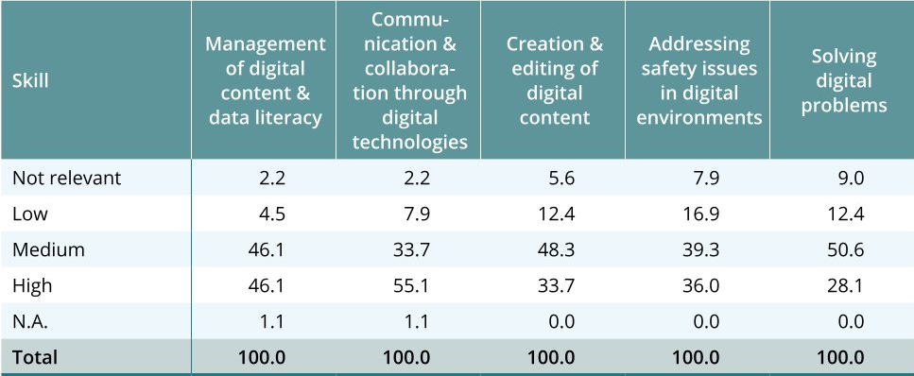
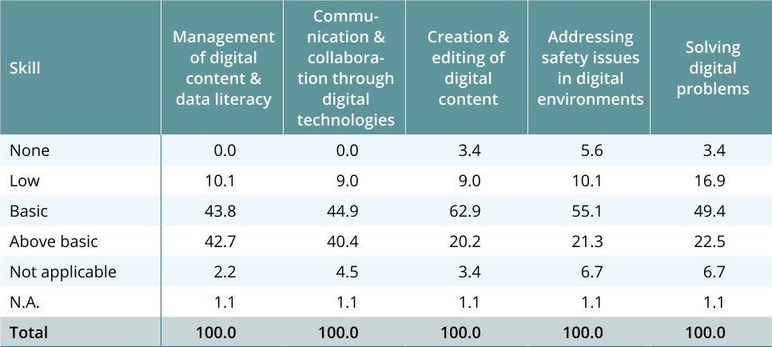
TECHNOLOGY AND DIGITAL SKILLS GAPS IN WISEs
ENABLERS: relevance of digital skills, needs and gaps
No significant discrepancies between the relevance of digital skills (upper table) and the level of endowment (lower table)
All competence areas are relevant for enablers:
  management of digital content and data literacy
  communication and collaboration through digital technologies
  creation and editing of digital content
  addressing safety issues in digital environments
  solving digital problems
This goes together with the level of endowment
Notes:
N.A. = Not answered

Slide 15
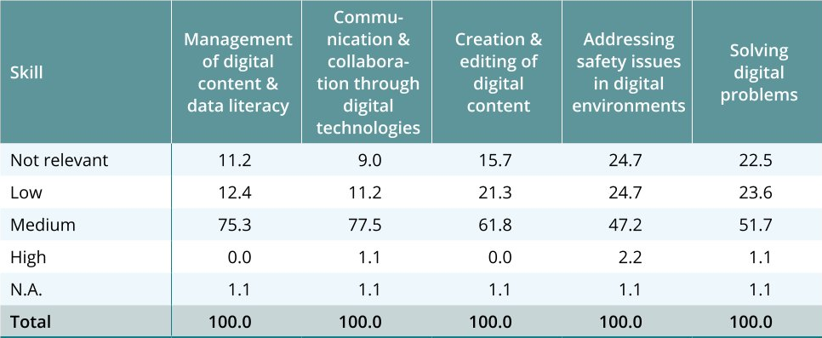
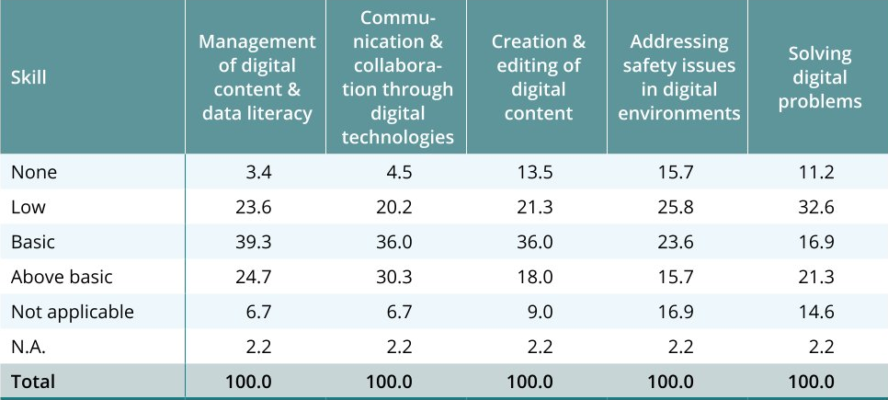
TECHNOLOGY AND DIGITAL SKILLS GAPS IN WISEs
SUPPORTERS: relevance of digital skills, needs and gaps
According to enablers, following competence areas are most relevant for supporters:
  management of digital content and data literacy
  communication and collaboration through digital technologies
According to enablers, 9.7% of supporters have no digital skills, 24.7% have a low level, 30.4% a basic level and 22% an above basic level of digital skills
For the 2 competence areas considered as most relevant for supporters, over 60% of supporters have a level of endowment that is basic or above basic

Slide 16
TECHNOLOGY AND DIGITAL SKILLS GAPS IN WISEs
SUPPORTERS: relevance of digital skills, needs and gaps
Self-assessment: use of digital skills at work vs. at home
Supporters use and need digital skills both at work and at home
Although the use and importance of digital skills at work is high, supporters use more digital skills at home
Only basic and advanced software skills for content manipulation
(e.g., word processing software, spreadsheet software or software to edit photos, videos or audio files) are more frequently applied at work

Slide 17
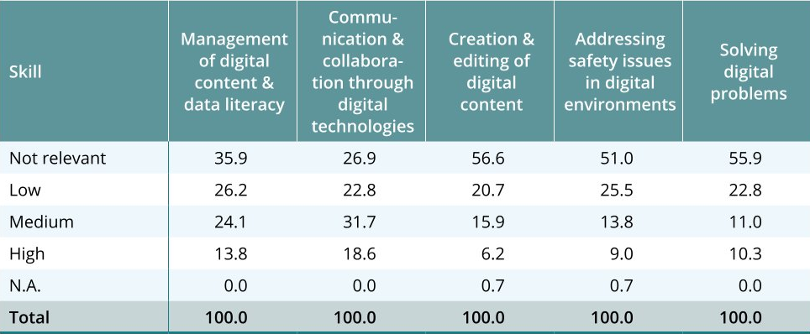
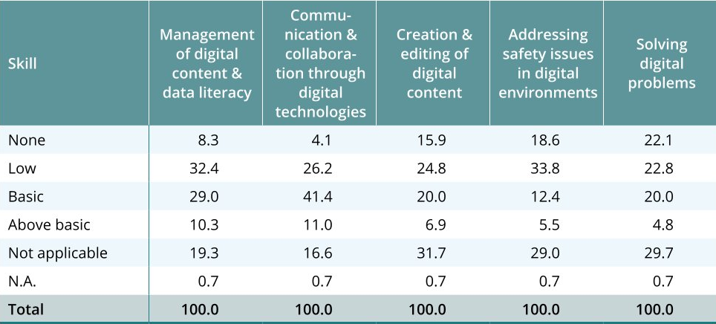
TECHNOLOGY AND DIGITAL SKILLS GAPS IN WISEs
WSNs: relevance of digital skills, needs and gaps
Overall, according to supporters, digital skills are not very relevant for WSNs at work
According to supporters, following competence areas are most relevant for WSNs:
  management of digital content and data literacy
  communication and collaboration through digital technologies
  According to supporters, 13.8% of WSNs have no digital skills, 28% a low, 24.6% a basic and 7.7% an above basic level of digital skills
  According to supporters, there are no significant digital skills gaps among WSNs: relevance and level of endowment go hand in hand

Slide 18
TECHNOLOGY AND DIGITAL SKILLS GAPS IN WISEs
WSNs: relevance of digital skills, needs and gaps
Self-assessment: use of digital skills at work vs. at home
Overall, WSNs use significantly fewer digital skills at work than at home
Information skills: 26.4% at work vs. 65.6% at home
Communication skills: 27.8% at work vs. 65.9% at home
Basic problem solving skills: 19.9% at work vs. 43.8% at home
Advanced problem solving skills: 9.6% at work vs. 41.3% at home
Basic software skills for content manipulation: 26.6% at work and 39.8% at home
Advanced software skills for content manipulation: 11.8% at work and 10% at home

Slide 19
TECHNOLOGY AND DIGITAL SKILLS GAPS IN WISEs
Digital skills training
Most WISEs do not provide training on digital skills themselves (exceptions: AUS / FRA / SPA / NL)
The larger the WISEs, the more likely they will provide training on digital skills
The main beneficiaries of training initiatives on digital skills are enablers, while WSNs' participation in training activities aimed at improving their proficiency on digital skills is lower
The fact that the level of endowment of digital skills is high for enablers shows that the current training initiatives meet their needs
Overall, a limited share of the WISEs interviewed (16.9%) have established partnerships with other local/regional organizations to promote external training initiatives for WSNs

Slide 20
TECHNOLOGY AND DIGITAL SKILLS GAPS IN WISEs
How to boost digitization and technologization in WISEs?
Technology and digital skills must be human-centered, or they will never be implemented in WISEs
Entrepreneurial mindset of the MGT will be key → In order to deploy more digital economic services to customers or to attract more complex work that requires a certain degree of digitization or technologization
Resources will be key → WISEs report lack of resources (e.g., budget, (digital / technical) skills, (technological / scientific) people, etc.) to invest in this direction
Scale will be key → Larger WISEs are more capable to offer training, to invest in technology, to pay attention to change management and adoption of technology, to set-up collaboration and co-creation, etc.

Slide 21
TECHNOLOGY AND DIGITAL SKILLS GAPS IN WISEs
How to boost digitization and technologization in WISEs?
Partnerships (e.g., with technological advanced companies, research centers, universities, other WISEs, etc.) will be key
Public interventions and policies can facilitate and boost digitization and technologization in WISEs → The most numerous and the most developed WISEs are in the countries where the attention for a strong and future-proof social economy has been and is highest

Slide 22
Thank you!
giulia.galera@euricse.eu
lieven.bossuyt@lichtwerk.io

